Slide 1
Query Processing and Optimization

Slide 2
Basic Steps in Query Processing
1. Parsing and translation
2. Optimization
3. Evaluation

Slide 3
Basic Steps in Query Processing (Cont.)
Parsing and translation
translate the query into its internal form. This is then translated into relational algebra.
Parser checks syntax, verifies relations
Evaluation
The query-execution engine takes a query-evaluation plan, executes that plan, and returns the answers to the query.

Slide 4
Basic Steps in Query Processing: Optimization
A relational algebra expression may have many equivalent expressions
E.g., σ_{salary<75000}(∏_{salary}(instructor)) is equivalent to ∏_{salary}(σ_{salary<75000}(instructor))
Each relational algebra operation can be evaluated using one of several different algorithms
Correspondingly, a relational-algebra expression can be evaluated in many ways.
Annotated expression specifying detailed evaluation strategy is called an evaluation-plan. E.g.,:
Use an index on salary to find instructors with salary < 75000,
Or perform complete relation scan and discard instructors with salary ≥ 75000

Slide 5
In this chapter, we discuss the techniques used by a DBMS to process high-level queries.
Steps of processing a high level query
Figure 18.1 shows the different steps of processing a high-level query.
A query expressed in a high-level query language such as SQL must first be scanned, parsed, and validated.
The scanner identifies the query tokens—such as SQL keywords, attribute names, and relation names—that appear in the text of the query.
The parser checks the query syntax to determine whether it is formulated according to the syntax rules of the query language.
The query must also be validated by checking that all attribute and relation names are valid and semantically meaningful names in the schema of the particular database being queried.
An internal representation of the query is then created, usually as a tree data structure called a query tree.
It is also possible to represent the query using a graph data structure called a query graph, which is generally a directed acyclic graph (DAG).

Slide 6
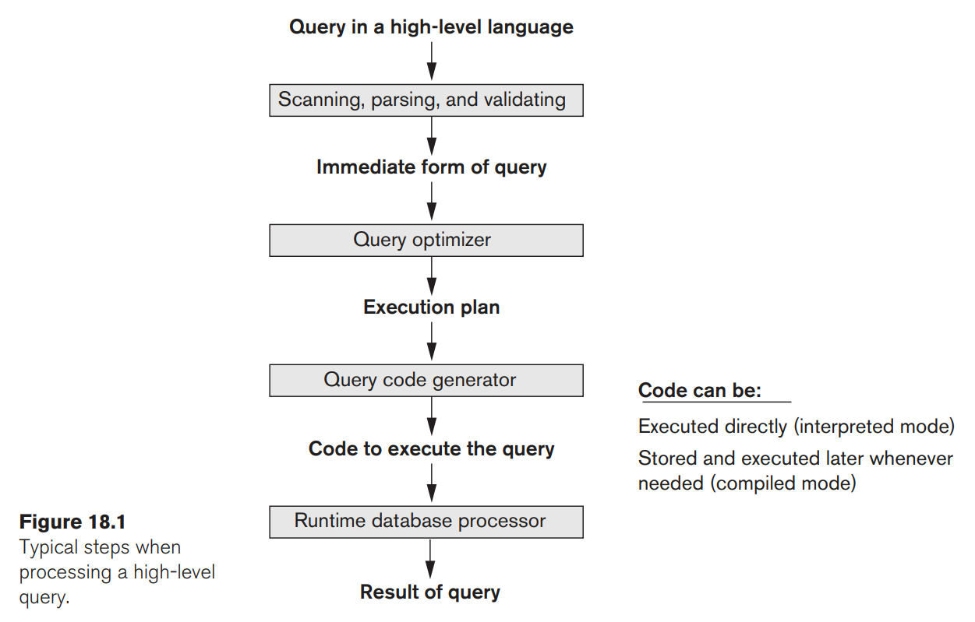

Slide 7
The DBMS must then devise an execution strategy or query plan for retrieving the results of the query from the database files.
A query has many possible execution strategies, and the process of choosing a suitable one for processing a query is known as query optimization.
The query optimizer module has the task of producing a good execution plan.
The code generator generates the code to execute that plan.
The runtime database processor has the task of running (executing) the query code to produce the query result.
If a runtime error results, an error message is generated by the runtime database processor.

Slide 8
Translating SQL Queries into Relational Algebra
SQL is the query language that is used in most commercial RDBMSs.
SQL queries are decomposed into query blocks that can be translated into the algebraic operators and optimized.
A query block contains a single SELECT-FROM-WHERE expression, as well as GROUP BY and HAVING clauses if these are part of the block.
Nested queries within a query are identified as separate query blocks.
Because SQL includes aggregate operators—such as MAX, MIN, SUM, and COUNT—these operators must also be included in the algebra.

Slide 9
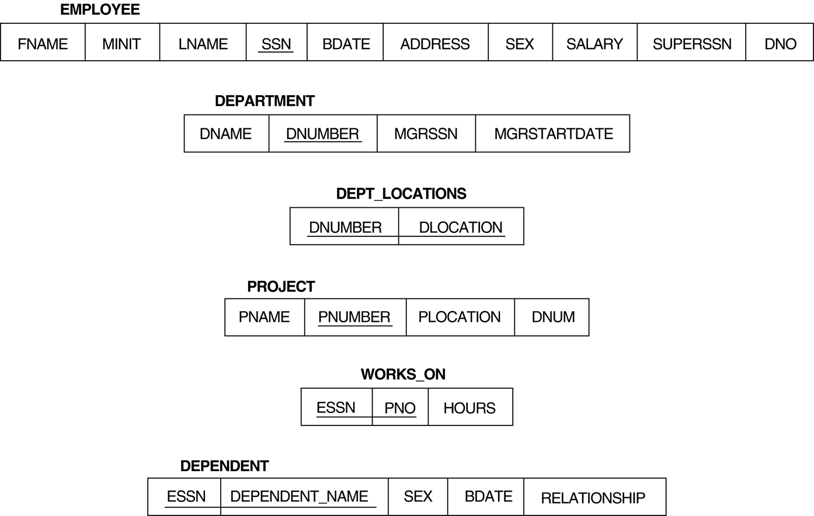

Slide 10
Consider the following SQL query on the EMPLOYEE relation shown above:
SELECT Lname, Fname
FROM EMPLOYEE
WHERE Salary > ( SELECT MAX (Salary)
FROM EMPLOYEE
WHERE Dno=5 );
This query retrieves the names of employees (from any department in the company) who earn a salary that is greater than the highest salary in department 5.
The query includes a nested subquery and hence would be decomposed into two blocks.
The inner block is:
( SELECT MAX (Salary)
FROM EMPLOYEE
WHERE Dno=5 )
This retrieves the highest salary in department 5.

Slide 11
The outer query block is:
SELECT Lname, Fname
FROM EMPLOYEE
WHERE Salary > c
where c represents the result returned from the inner block.
The inner block could be translated into the following relational algebra expression:
ℑ_{MAX Salary}(σ_{Dno=5}(EMPLOYEE))
and the outer block into the expression:
π_{Lname, Fname}(σ_{Salary>c}(EMPLOYEE))
The query optimizer would then choose an execution plan for each query block.
The inner block needs to be evaluated only once to produce the maximum salary of employees in department 5, which is then used—as the constant c—by the outer block.

Slide 12
Generating Equivalent Expressions

Slide 13
Transformation of Relational Expressions
Two relational algebra expressions are said to be equivalent if the two expressions generate the same set of tuples on every legal database instance
Note: order of tuples is irrelevant
we don’t care if they generate different results on databases that violate integrity constraints
In SQL, inputs and outputs are multisets of tuples
Two expressions in the multiset version of the relational algebra are said to be equivalent if the two expressions generate the same multiset of tuples on every legal database instance.
An equivalence rule says that expressions of two forms are equivalent
Can replace expression of first form by second, or vice versa

Slide 14
Equivalence Rules
1. Conjunctive selection operations can be deconstructed into a sequence of individual selections. σ_{θ1 ∧ θ2} (E) ≡ σ_{θ1} (σ_{θ2} (E))
2. Selection operations are commutative. σ_{θ1}(σ_{θ2}(E)) ≡ σ_{θ2} (σ_{θ1}(E))
3. Only the last in a sequence of projection operations is needed, the others can be omitted. ∏ _{L1}(∏ _{L2}(…(∏ _{Ln}(E))…)) ≡ ∏ _{L1}(E) where L₁ ⊆ L₂ … ⊆ L_{n}
4. Selections can be combined with Cartesian products and theta joins.
σ_{θ} (E₁ x E₂) ≡ E₁ ⨝ _{θ} E₂
σ _{θ1} (E₁ ⨝_{θ2} E₂) ≡ E₁ ⨝ _{θ1∧θ2} E₂

Slide 15
Equivalence Rules (Cont.)
5. Theta-join operations (and natural joins) are commutative. E₁ ⨝ E₂ ≡ E₂ ⨝ E₁
6. (a) Natural join operations are associative:
(E₁ ⨝ E₂) ⨝ E₃ ≡ E₁ ⨝ (E₂ ⨝ E₃) (b) Theta joins are associative in the following manner: (E₁ ⨝ _{θ1} E₂) ⨝ _{θ2 ∧ θ3} E₃ ≡ E₁ ⨝_{θ1 ∧ θ3} (E₂ ⨝ _{θ2} E₃) where θ₂ involves attributes from only E₂ and E₃.

Slide 16
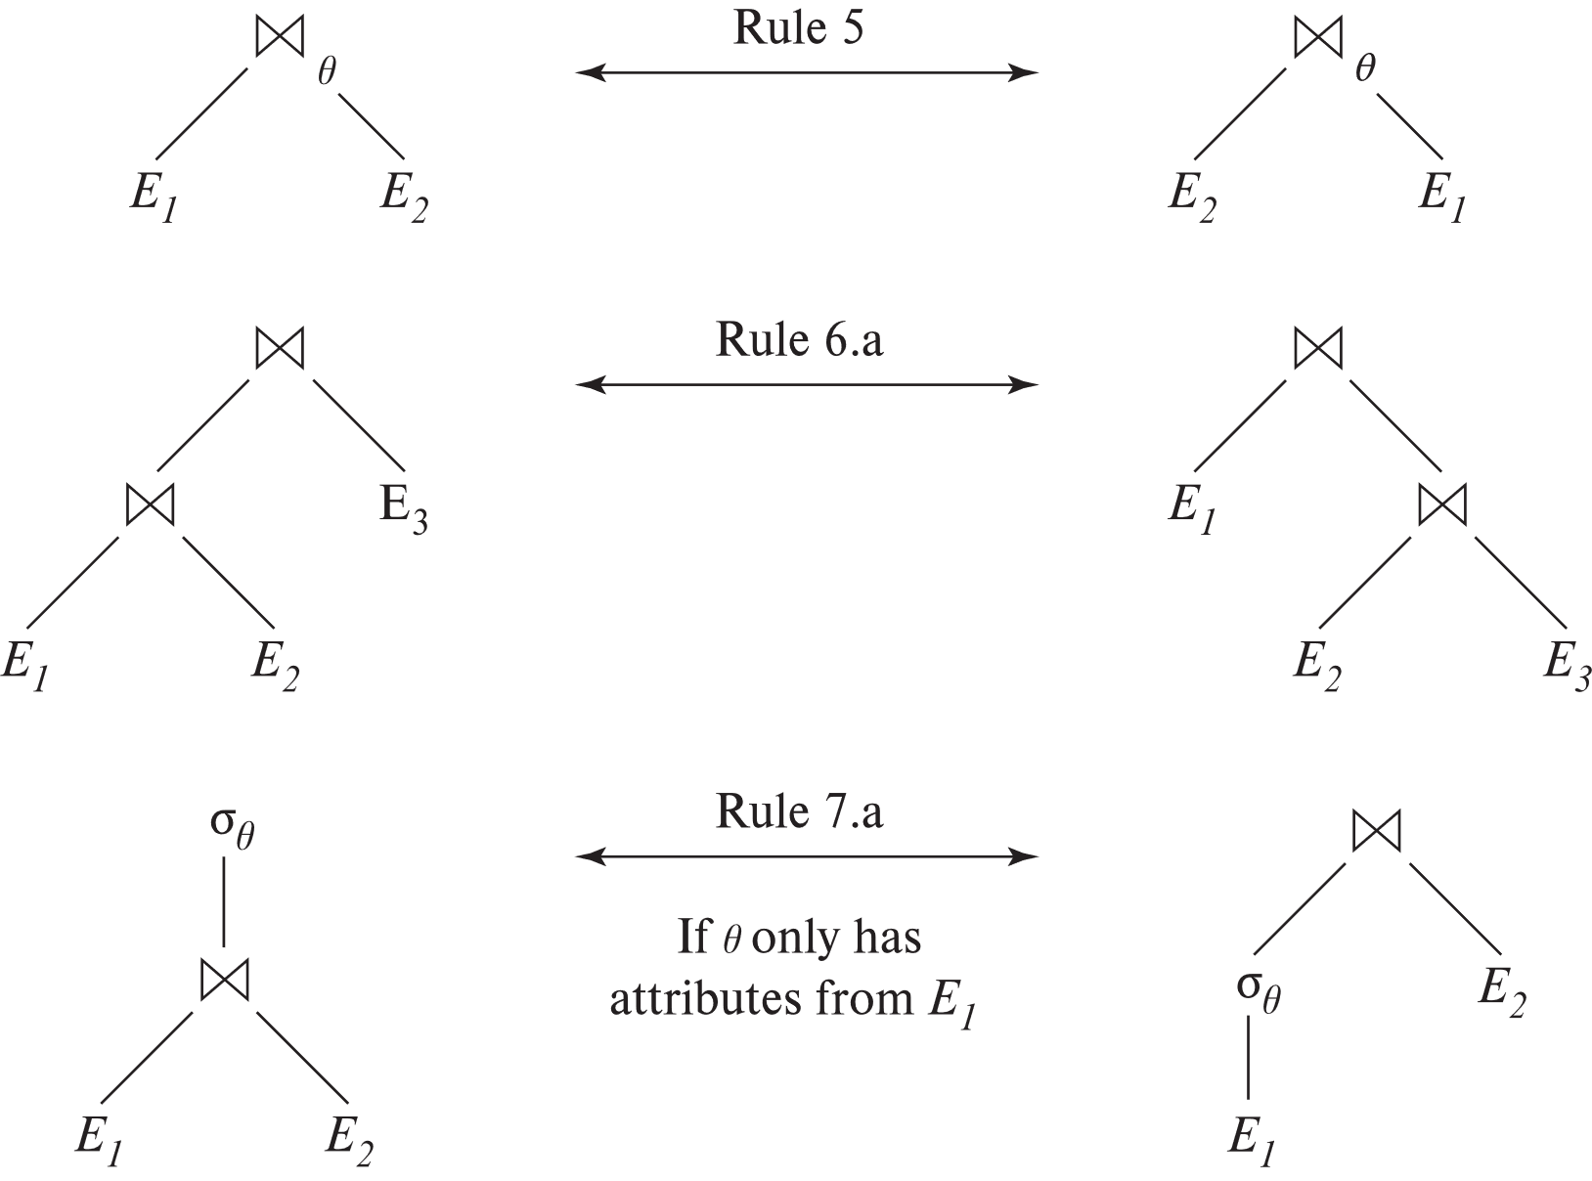
Pictorial Depiction of Equivalence Rules

Slide 17
Equivalence Rules (Cont.)
7. The selection operation distributes over the theta join operation under the following two conditions: (a) When all the attributes in θ₀ involve only the attributes of one of the expressions (E₁) being joined. σ_{θ0} (E₁ ⨝_{θ} E₂) ≡ (σ_{θ0}(E₁)) ⨝_{θ} E₂
(b) When θ₁ involves only the attributes of E₁ and θ₂ involves only the attributes of E₂.
σ_{θ1 ∧ θ2} (E₁ ⨝_{θ} E₂) ≡ (σ_{θ1}(E₁)) ⨝_{θ} (σ_{θ2}(E₂))

Slide 18
Equivalence Rules (Cont.)
8. The projection operation distributes over the theta join operation as follows:
(a) if θ involves only attributes from L₁ ∪ L₂: ∏ _{L1 ∪ L2}(E₁ ⨝_{θ} E₂) ≡ ∏ _{L1}(E₁) ⨝_{θ} ∏ _{L2}(E₂)
(b) In general, consider a join E₁ ⨝_{θ} E₂.
Let L₁ and L₂ be sets of attributes from E₁ and E₂, respectively.
Let L₃ be attributes of E₁ that are involved in join condition θ, but are not in L₁ ∪ L₂, and
let L₄ be attributes of E₂ that are involved in join condition θ, but are not in L₁ ∪ L₂. ∏ _{L1 ∪ L2}(E₁ ⨝_{θ} E₂) ≡ ∏ _{L1 ∪ L2}(∏ _{L1 ∪ L3}(E₁) ⨝_{θ} ∏ _{L2 ∪ L4}(E₂))
Similar equivalences hold for outerjoin operations: ⟕, ⟖, and ⟗

Slide 19
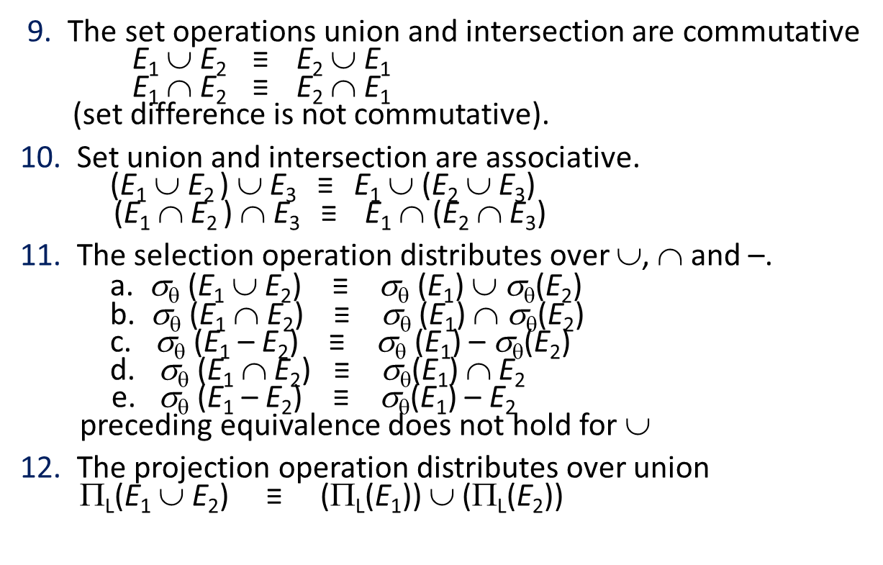
Equivalence Rules (Cont.)
9. The set operations union and intersection are commutative E₁ ∪ E₂ ≡ E₂ ∪ E₁ E₁ ∩ E₂ ≡ E₂ ∩ E₁ (set difference is not commutative).
10. Set union and intersection are associative. (E₁ ∪ E₂ ) ∪ E₃ ≡ E₁ ∪ (E₂ ∪ E₃) (E₁ ∩ E₂ ) ∩ E₃ ≡ E₁ ∩ (E₂ ∩ E₃)
11. The selection operation distributes over ∪, ∩ and –. a. σ_{θ} (E₁ ∪ E₂) ≡ σ_{θ} (E₁) ∪ σ_{θ}(E₂) b. σ_{θ} (E₁ ∩ E₂) ≡ σ_{θ} (E₁) ∩ σ_{θ}(E₂) c. σ_{θ} (E₁ – E₂) ≡ σ_{θ} (E₁) – σ_{θ}(E₂) d. σ_{θ} (E₁ ∩ E₂) ≡ σ_{θ}(E₁) ∩ E₂ e. σ_{θ} (E₁ – E₂) ≡ σ_{θ}(E₁) – E₂ preceding equivalence does not hold for ∪
12. The projection operation distributes over union Π_{L}(E₁ ∪ E₂) ≡ (Π_{L}(E₁)) ∪ (Π_{L}(E₂))

Slide 20
Exercise
Create equivalence rules involving
The group by/aggregation operation
Left outer join operation

Slide 21
Equivalence Rules (Cont.)
13. Selection distributes over aggregation as below σ_{θ}(_{G}𝛾_{A}(E)) ≡ _{G}𝛾_{A}(σ_{θ}(E)) provided θ only involves attributes in G
14. a. Full outerjoin is commutative: E₁ ⟗ E₂ ≡ E₂ ⟗ E₁ b. Left and right outerjoin are not commutative, but: E₁ ⟕ E₂ ≡ E₂ ⟖ E₁
15. Selection distributes over left and right outerjoins as below, provided θ₁
only involves attributes of E₁ a. σ_{θ1} (E₁ ⟕_{θ} E₂) ≡ (σ_{θ1} (E₁)) ⟕_{θ} E₂ b. σ_{θ1} (E₁ ⟖_{θ} E₂) ≡ E₂ ⟕_{θ} (σ_{θ1} (E₁))
16. Outerjoins can be replaced by inner joins under some conditions
a. σ_{θ1} (E₁ ⟕_{θ} E₂) ≡ σ_{θ1} (E₁ ⨝_{θ} E₂) b. σ_{θ1} (E₁ ⟖_{θ} E₁) ≡ σ_{θ1} (E₁ ⨝_{θ} E₂) provided θ₁ is null rejecting on E₂

Slide 22
Equivalence Rules (Cont.)
Note that several equivalences that hold for joins do not hold for outerjoins
σ_{year=2017}(instructor ⟕ teaches) ≢ σ_{year=2017}(instructor ⨝ teaches)
Outerjoins are not associative (r ⟕ s) ⟕ t ≢ r ⟕ (s ⟕ t)
e.g. with r(A,B) = {(1,1), s(B,C) = { (1,1)}, t(A,C) = { }
Notes:
How about (r ⟕ s) ⟕ t vs (r ⟕ t) ⟕ s assuming r has common attributes with s and t? Hint: consider 2 cases where s and t have common attributes and those where they have no common attribute

Slide 23
Query Optimization
The goal of query optimization is to select the best possible strategy for query evaluation.
Query Trees and Heuristics for Query Optimization
In this section, we discuss optimization techniques that apply heuristic rules to modify the internal representation of a query—which is usually in the form of a query tree or a query graph data structure—to improve its expected performance.
The scanner and parser of an SQL query first generate a data structure that corresponds to an initial query representation, which is then optimized according to heuristic rules.
This leads to an optimized query representation, which corresponds to the query execution strategy.
Following that, a query execution plan is generated to execute groups of operations based on the access paths available on the files involved in the query.

Slide 24
Query Trees
A query tree is a tree data structure that corresponds to a relational algebra expression.
The input relations of the query are represented as leaf nodes of the tree and the relational algebra operations are represented as internal nodes.
The order of execution of operations starts at the leaf nodes and ends at the root node.
An operation at an internal node is executed whenever its operands are available and then that internal node is replaced by the relation that results from executing the operation.
The execution terminates when the root node operation is executed and produces the result relation for the query.

Slide 25
Consider the following query on the COMPANY relational schema:
For every project located in ‘Stafford’, retrieve the project number, the controlling department number, and the department manager’s last name, address, and birthdate.
The corresponding SQL query is:
SELECT P.Pnumber, P.Dnum, E.Lname, E.Address, E.Bdate
FROM PROJECT P, DEPARTMENT D, EMPLOYEE E
WHERE P.Plocation= ‘Stafford’ AND P.Dnum=D.Dnumber AND D.Mgr_ssn=E.Ssn;
The corresponding relational algebra expression is:
πPnumber, Dnum, Lname, Address, Bdate (((σ_{Plocation=‘Stafford’}(PROJECT)) _{Dnum=Dnumber}(DEPARTMENT)) _{Mgr_ssn=Ssn}(EMPLOYEE))
Figure 19.1(a) shows a query tree for the above query. The leaf nodes P, D, and E represent the three relations PROJECT, DEPARTMENT, and EMPLOYEE, respectively, and the internal nodes represent the relational algebra operations of the expression.
When this query tree is executed, the node marked (1) in Figure 19.1(a) must begin execution before node (2) because some resulting tuples of operation (1) must be available before we can begin executing operation (2).

Slide 26
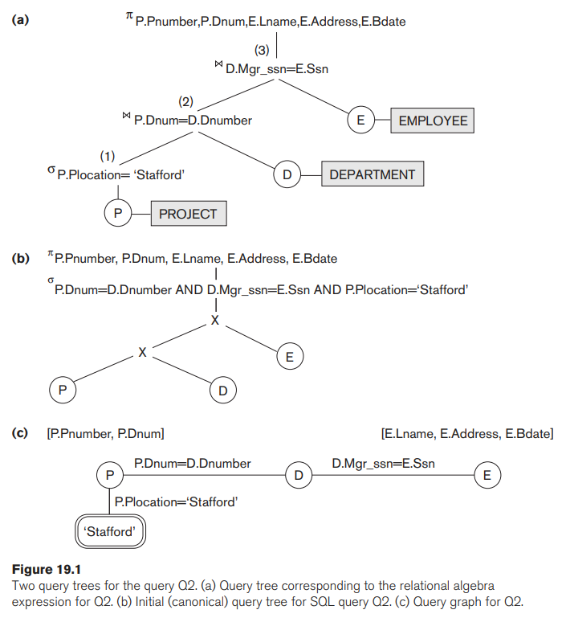

Slide 27
Similarly, node (2) must begin executing and producing results before node (3) can start execution, and so on.
Query Graphs
A more neutral data structure for representation of a query is the query graph notation.
Figure 19.1(c) shows the query graph for the above query.
Relations in the query are represented by relation nodes, which are displayed as single circles.
Constant values, typically from the query selection conditions, are represented by constant nodes, which are displayed as double circles or ovals.
Selection and join conditions are represented by the graph edges, as shown in Figure 19.1(c).
Finally, the attributes to be retrieved from each relation are displayed in square brackets above each relation.
The query graph representation does not indicate an order on which operations to perform first. There is only a single graph corresponding to each query.

Slide 28
Heuristic Optimization of Query Trees
Many different relational algebra expressions—and hence many different query trees—can be generated for the same SQL query.
For an SQL query, the query parser will typically generate a standard initial query tree without doing any optimization.
For example, for a SELECT-PROJECT-JOIN query, the initial tree is shown in Figure 19.1(b).
The CARTESIAN PRODUCT of the relations specified in the FROM clause is first applied; then the selection and join conditions of the WHERE clause are applied, followed by the projection on the SELECT clause attributes.
Such a canonical query tree represents a relational algebra expression that is very inefficient if executed directly, because of the CARTESIAN PRODUCT (×) operations.
For example, if the PROJECT, DEPARTMENT, and EMPLOYEE relations had record sizes of 100, 50, and 150 bytes and contained 100, 20, and 5,000 tuples, respectively, the result of the CARTESIAN PRODUCT would contain 10 million tuples of record size 300 bytes each.
The heuristic query optimizer will transform this initial query tree into an equivalent final query tree that is efficient to execute.

Slide 29
General Transformation Rules for Relational Algebra Operations
Some transformation rules that are useful in query optimization are:
1. Cascade of σ: A conjunctive selection condition can be broken up into a cascade (sequence) of individual σ operations:
σ _{c1 AND c2 AND ... AND cn}(R) = σ_{c1} (σ_{c2} (...(σ_{cn}(R))...) )
2. Commutativity of σ: The σ operation is commutative:
σ_{c1} (σ_{c2}(R)) = σ_{c2} (σ_{c1}(R))
3. Cascade of π: In a cascade (sequence) of π operations, all but the last one can be ignored:
π_{List1} (π_{List2} (...(π_{Listn}(R))...) ) = π_{List1}(R)

Slide 30
4. Commuting σ with π: If the selection condition c involves only the attributes A1, ..., An in the projection list, the two operations can be commuted:
π_{A1, A2, ..., An} (σ_{c} (R)) = σ_{c} (π_{A1, A2, ..., An} (R))
5. Commutativity of (and X ): The operation is commutative as is the X operation:
R _{C} S = S _{C} R; R x S = S x R
6. Commuting σ with (or X ): If all the attributes in the selection condition c involve only the attributes of one of the relations being joined—say, R—the two operations can be commuted as follows:
σ_{c} ( R S ) = (σ_{c} (R)) S
Alternatively, if the selection condition c can be written as (c1 and c2), where condition c1 involves only the attributes of R and condition c2 involves only the attributes of S, the operations commute as follows:
σ_{c} ( R S ) = (σ_{c1} (R)) (σ_{c2} (S))
The same rules apply if the is replaced by a X operation.

Slide 31
7. Commuting π with (or X): Suppose that the projection list is L = {A1, ..., An, B1, ..., Bm}, where A1, ..., An are attributes of R and B1, ..., Bm are attributes of S. If the join condition c involves only attributes in L, the two operations can be commuted as follows:
π_{L} ( R _{C} S ) = (π_{A1, ..., An} (R)) _{C} (π_{B1, ..., Bm} (S))
If the join condition c contains additional attributes not in L, these must be added to the projection list, and a final π operation is needed. For example, if attributes An+1, … , An+k of R and Bm+1, … , Bm+p of S are involved in the join condition c but are not in the projection list L, the operations commute as follows:
π_{L} (R c S) ≡ π_{L} ((π_{A1, … , An, An+1, … , An+k}(R)) c (π_{B1, … , Bm, Bm+1, … , Bm+p} (S)))
For X, there is no condition c, so the first transformation rule always applies by replacing c with X.
8. Commutativity of set operations: The set operations ∪ and ∩ are commutative, but − is not.
9. Associativity of , X, ∪, and ∩: These four operations are individually associative; that is, if both occurrences of θ stand for the same operation that is any one of these four operations (throughout the expression), we have:
(R θ S) θ T ≡ R θ (S θ T)

Slide 32
10. Commuting σ with set operations: The σ operation commutes with ∪, ∩, and −. If θ stands for any one of these three operations (throughout the expression), we have:
σ_{c} (R θ S) ≡ (σ_{c} (R)) θ (σ_{c} (S))
11. The π operation commutes with ∪:
π_{L} (R ∪ S) ≡ (π_{L} (R)) ∪ (π_{L} (S))
12. Converting a (σ, X) sequence into : If the condition c of a σ that follows a X corresponds to a join condition, convert the (σ, X) sequence into a as follows:
(σ_{c} (R X S)) ≡ (R c S)

Slide 33
Outline of a Heuristic Algebraic Optimization Algorithm
We can now outline the steps of an algorithm that utilizes some of the above rules to transform an initial query tree into a final tree that is more efficient to execute.
The steps of the algorithm are as follows:
1. Using Rule 1, break up the SELECT operations with conjunctive conditions into a cascade of SELECT operations.
2. Using Rules 2, 4, 6, and 10 concerning the commutativity of SELECT with other operations, move each SELECT operation as far down the query tree as is permitted by the attributes involved in the select condition.
3. Using Rules 5 and 9 concerning commutativity and associativity of binary operations, rearrange the leaf nodes of the tree using the following criteria. Position the leaf node relations with the most restrictive SELECT operations so they are executed first in the query tree representation. Make sure that the ordering of leaf nodes does not cause CARTESIAN PRODUCT operations.
4. Using Rule 12, combine a CARTESIAN PRODUCT operation with a subsequent SELECT operation in the tree into a JOIN operation, if the condition represents a join condition.

Slide 34
5. Using Rules 3, 4, 7, and 11 concerning the cascading of PROJECT and the commuting of PROJECT with other operations, break down and move lists of projection attributes down the tree as far as possible by creating new PROJECT operations as needed.
6. Identify subtrees that represent groups of operations that can be executed by a single algorithm.
In our example, Figure 19.2(b) shows the tree in Figure 19.2(a) after applying steps 1 and 2 of the algorithm;
Figure 19.2(c) shows the tree after step 3; Figure 19.2(d) after step 4; and Figure 19.2(e) after step 5.
In step 6, we may group together the operations in the subtree whose root is the operation π_{Essn} into a single algorithm.

Slide 35
Example of Transforming a Query
Consider the following query Q on the COMPANY database:
Find the last names of employees born after 1957 who work on a project named ‘Aquarius’.
This query can be specified in SQL as follows:
Q: SELECT E.Lname
FROM EMPLOYEE E, WORKS_ON W, PROJECT P
WHERE P.Pname=‘Aquarius’ AND P.Pnumber=W.Pno AND W.Essn=E.Ssn AND E.Bdate > ‘1957-12-31’;
The initial query tree for Q is shown in Figure 19.2(a).

Slide 36
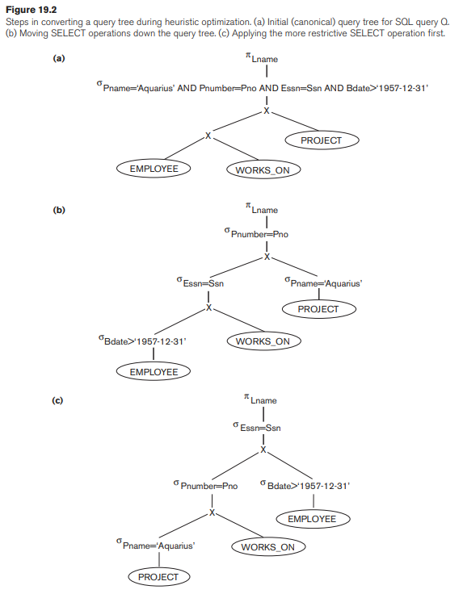

Slide 37
Executing this tree directly first creates a very large file containing the CARTESIAN PRODUCT of the entire EMPLOYEE, WORKS_ON, and PROJECT files.
That is why the initial query tree is never executed, but is transformed into another equivalent tree that is efficient to execute.
This particular query needs only one record from the PROJECT relation— for the ‘Aquarius’ project—and only the EMPLOYEE records whose date of birth is after ‘1957-12-31’.
Figure 19.2(b) shows an improved query tree that first applies the SELECT operations to reduce the number of tuples that appear in the CARTESIAN PRODUCT.
A further improvement is achieved by switching the positions of the EMPLOYEE and PROJECT relations in the tree, as shown in Figure 19.2(c).
This uses the information that Pnumber is a key attribute of the PROJECT relation, and hence the SELECT operation on the PROJECT relation will retrieve a single record only.
We can further improve the query tree by replacing any CARTESIAN PRODUCT operation that is followed by a join condition as a selection with a JOIN operation, as shown in Figure 19.2(d).

Slide 38
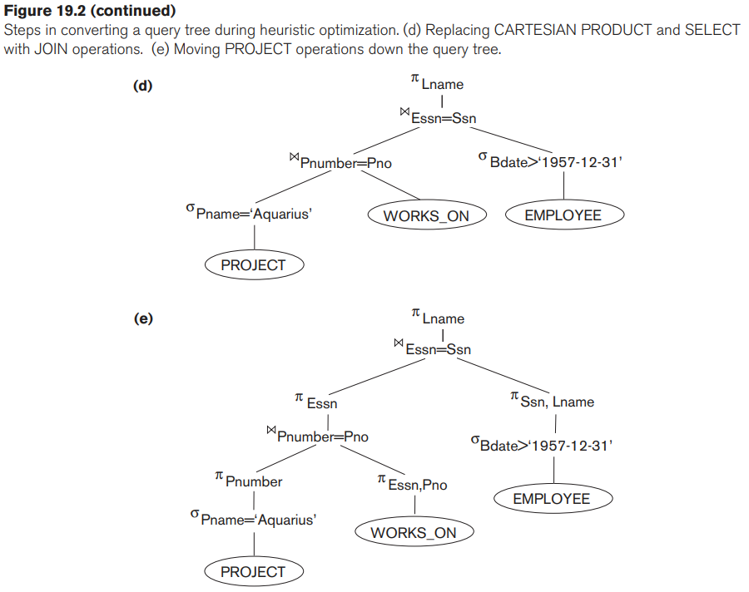

Slide 39
Another improvement is to keep only the attributes needed by subsequent operations in the intermediate relations, by including PROJECT (π) operations as early as possible in the query tree, as shown in Figure 19.2(e).
This reduces the attributes (columns) of the intermediate relations, whereas the SELECT operations reduce the number of tuples (records).

Slide 40
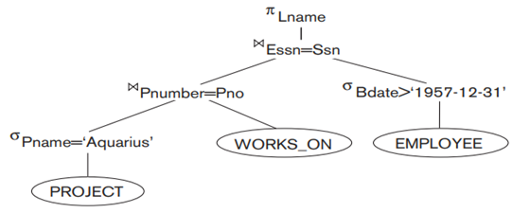
SELECT E.Lname
FROM EMPLOYEE E, WORKS_ON W, PROJECT P
WHERE P.Pname=‘Aquarius’ AND P.Pnumber=W.Pno AND W.Essn=E.Ssn AND E.Bdate > ‘1957-12-31’;
π_{Lname} ((((σ_{Pname=‘Aquarius’}(PROJECT)) _{Pnumber=Pno}(WORKS_on))) _{Essn=Ssn}(σ_{E.Bdate>‘1957-12-31’} (EMPLOYEE)))

